Slide 1
CLAS 220: Introduction to Classical Mythology
Lecture 1: Introduction to the Course

Slide 2
What is Myth?

Slide 3
What is myth?
An authoritative story about the world, accepted within a given community as true
The truths involved can be at all levels: spiritual, cosmological, political, social, psychological
Whether the stories are true or not, in a factual sense, they “work” as a way of understanding the world

Slide 4
What is myth?
Mythos vs. Logos:
Originally:
Mythos: authoritative story about the world
Logos: just one of many stories; not authoritative
Later:
Mythos: marked as “not true”
Logos: marked as true, not because it works, but because it’s right

Slide 5
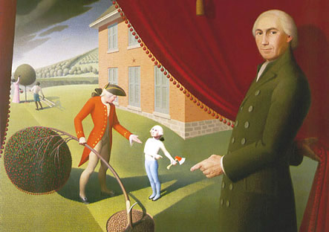
What is myth?
George Washington and the Cherry Tree

Slide 6
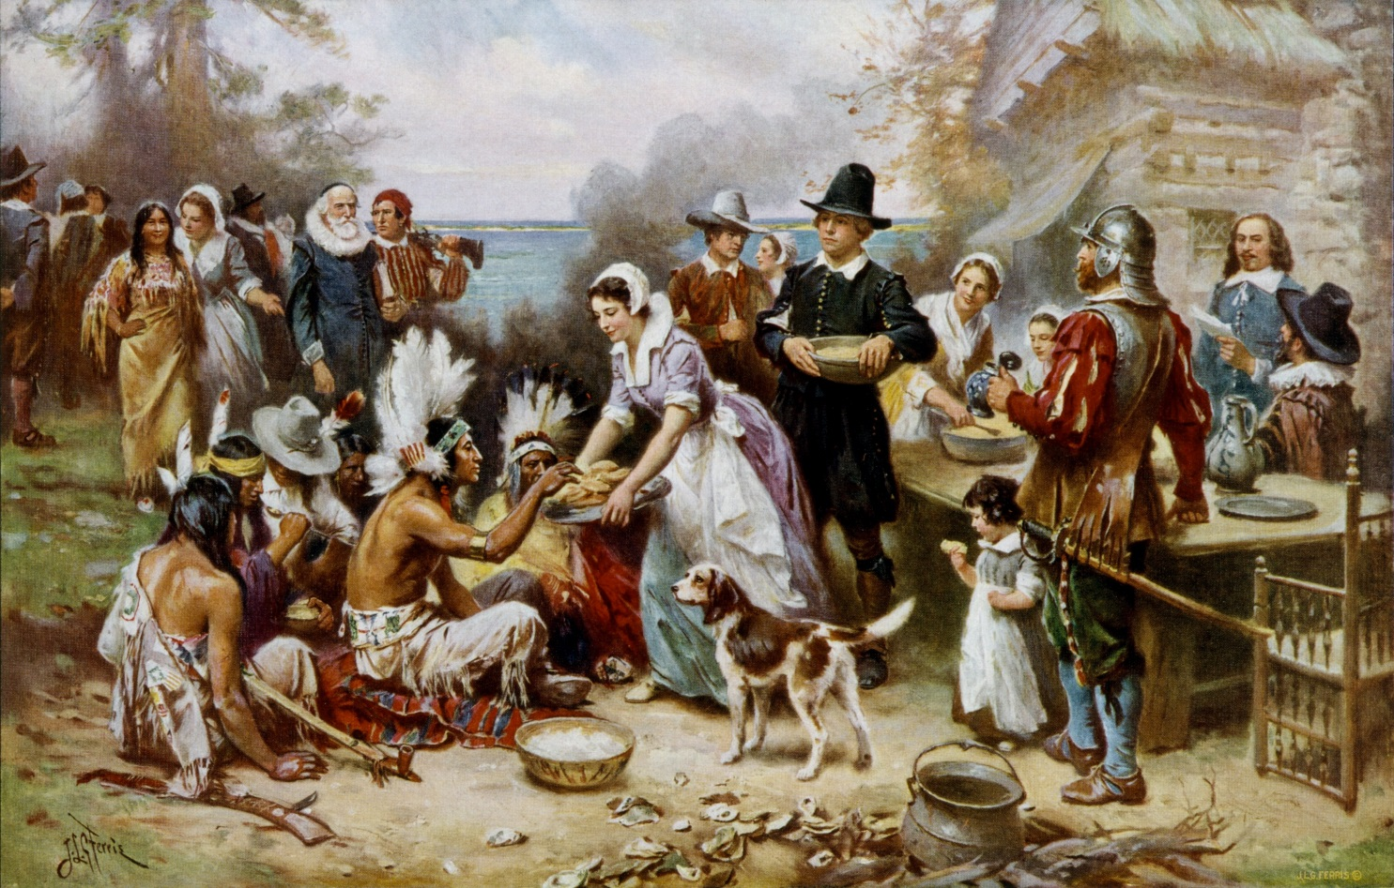
What is myth?
The First Thanksgiving

Slide 7
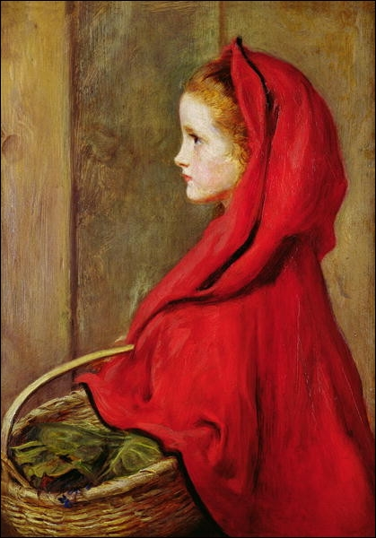
What is myth?
Myths can take many forms. How many variations on the tale of Little Red Riding Hood do you know?

Slide 8
What is myth?
In ancient Greece and Rome, myths were presented in many forms – in sculptures, paintings, vases; in oral storytelling, in song and in dance.
But much of what we know about Greek and Roman myth we know from literary texts, and so that’s the focus of this course.

Slide 9
The Origins of MYTh

Slide 10

The Origins of Myth
Myth comes from a variety of sources, including
-- personifying and explaining natural forces

Slide 11
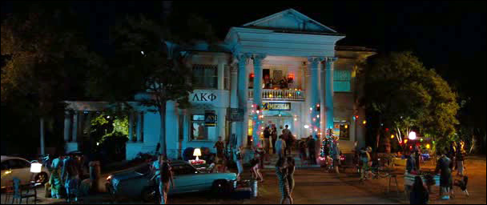
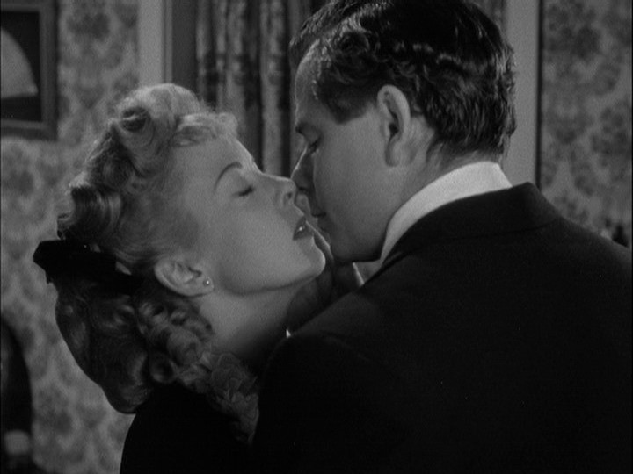
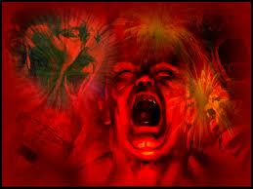
The Origins of Myth
Myth comes from a variety of sources, including
-- personifying psychological forces

Slide 12
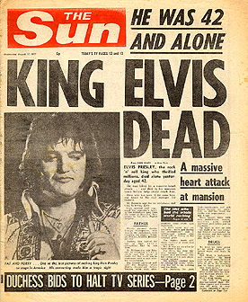
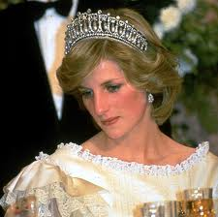
The Origins of Myth
Myth comes from a variety of sources, including
-- memorable historical events

Slide 13
What is ritual?

Slide 14
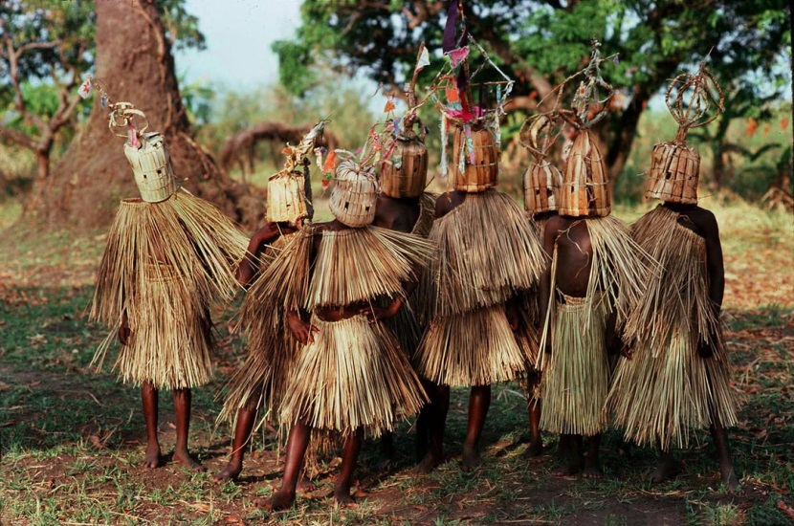

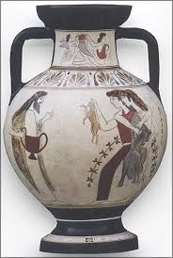
What is ritual?
Regularly recurring action
Done for its symbolic value
special places, times, words,
objects, people
Set apart from daily life

Slide 15
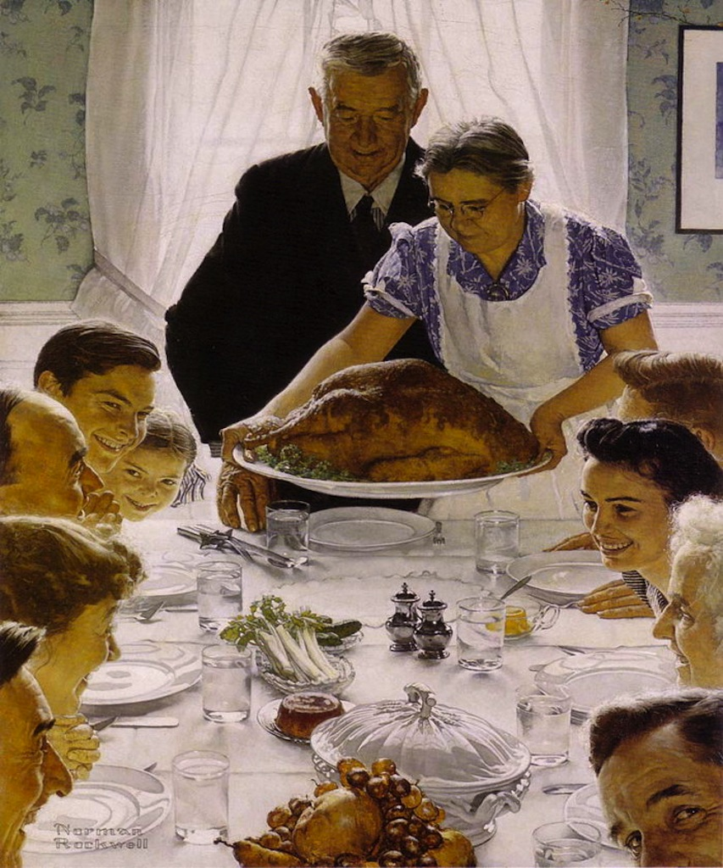
What is ritual?
A familiar American ritual

Slide 16
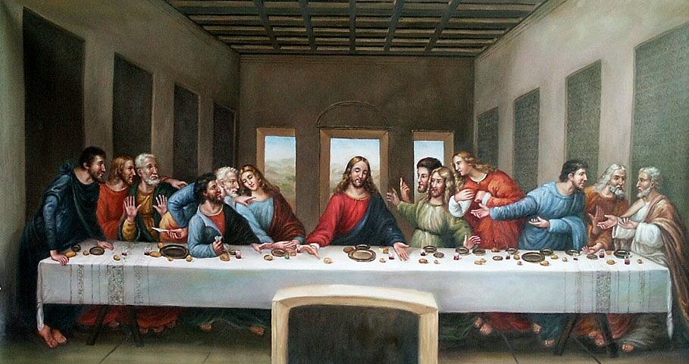
What is ritual?
A major Christian ritual

Slide 17
What is religion?
Religion = myth + ritual
myth explains ritual, and gives it a context
ritual brings myth into the here-and-now
In the case of Greece and Rome, the rituals are gone (though we know a little bit about them)
What remains are the myths,
or their representations in literature
This is also why ancient Greek texts about mythology are not scripture – for the Greeks, they needed to be performed or reenacted in ritual, to be sacred.

Slide 18
Greek Religion
No word for “religion” in Greek or Latin,
because it’s not separable from the rest of life
Myth and ritual are part of daily family life, of citizenship,
of business, of sports, of the arts
Both a “Panhellenic” (=“All Greek”) and a local dimension

Slide 19
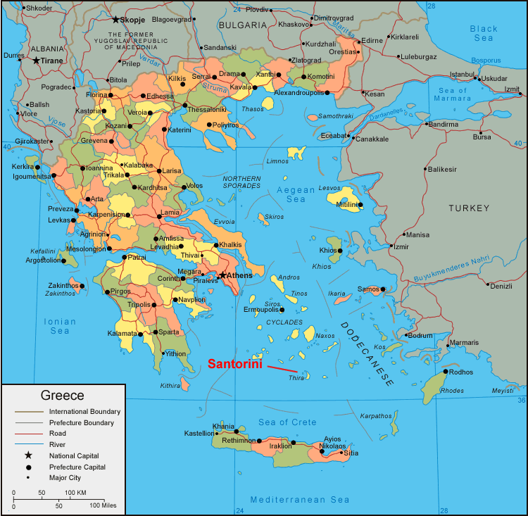
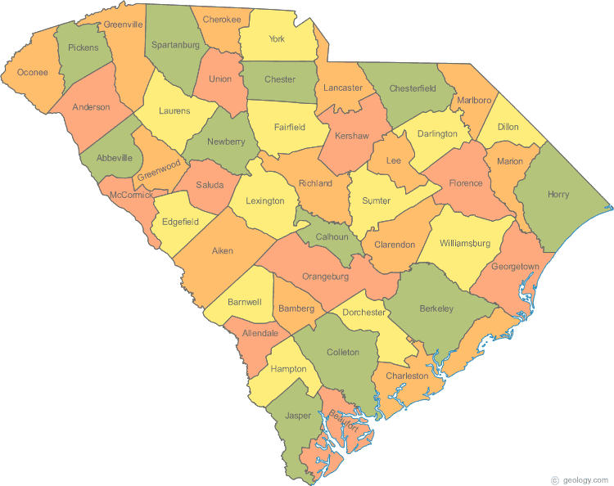
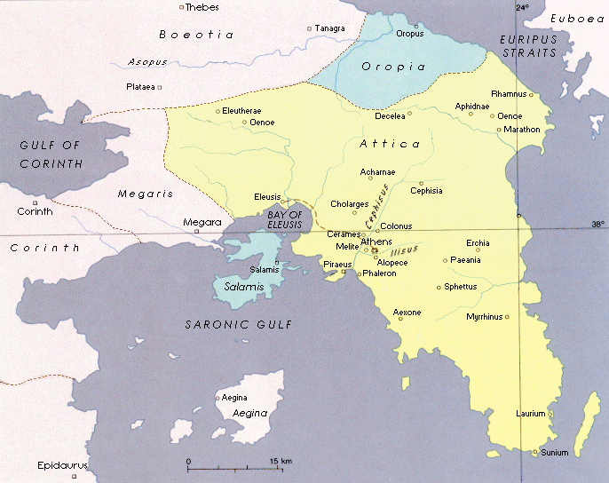
Panhellenic Myth and Ritual
Greece divided into many tiny city-states
"city-state" = polis

Slide 20
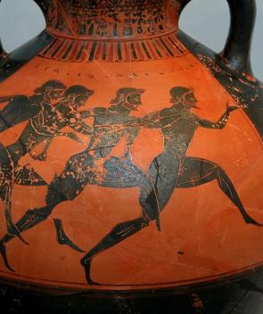
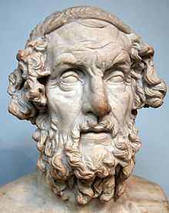
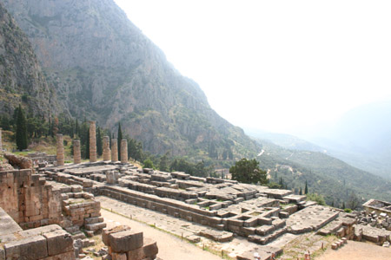
Panhellenic Myth and Ritual
Greece divided into many tiny city-states
But they share many cultural institutions:
Olympic Games
Delphic oracle
Homeric Epic

Slide 21
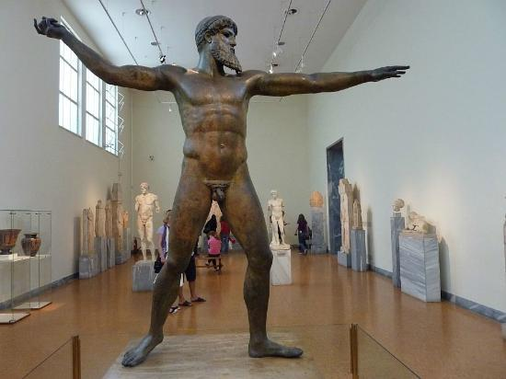
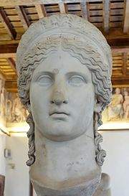
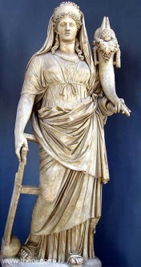
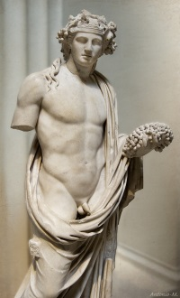
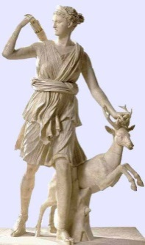
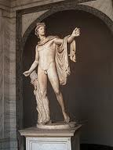
The Panhellenic Gods
The Greeks had many gods (and always had room for more);
but a dozen or so, the Olympian gods, were the most important
Worshipped everywhere in the Greek world
Sometimes under different names or in different ways
Associated with the various forces of natural and human life
(sun, moon, rain, sea, love/sex, food, drink, death, music…)
Not necessarily good, or concerned with human problems

Slide 22
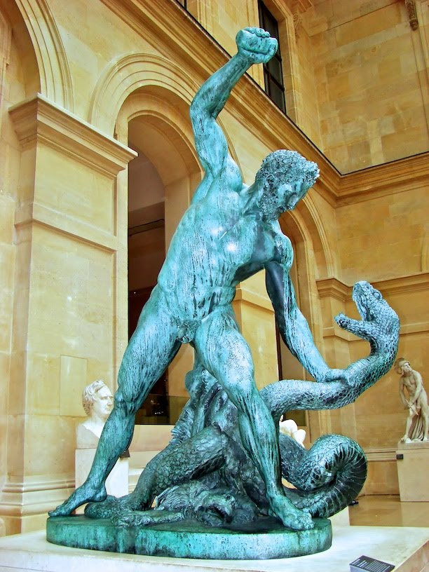
Local Religion
Olympian gods important to local religion as well
Also gods of local places: springs, rivers, trees, mountains
But most important aspect of local religion: the hero

Slide 23
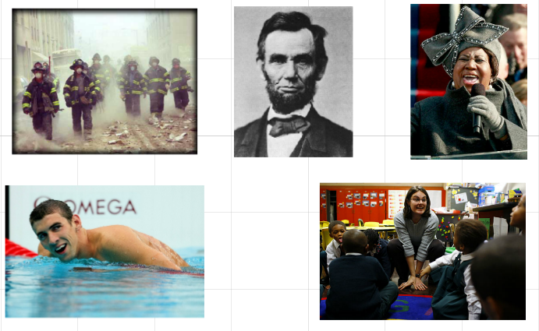
Heroes
Contemporary Heroes

Slide 24
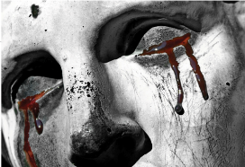

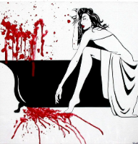
Ancient Heroes
Much more complicated; not always good

